Slide 1
Builder.io
Enhance webdev with AI

Slide 2
Builder.io
VISUAL COPILOT

Slide 3
Convert Figma
into code

Slide 4
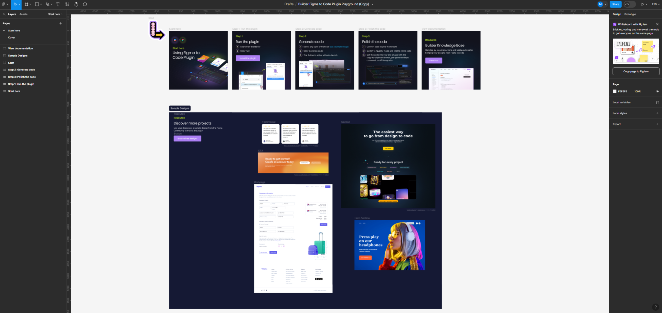

Slide 5
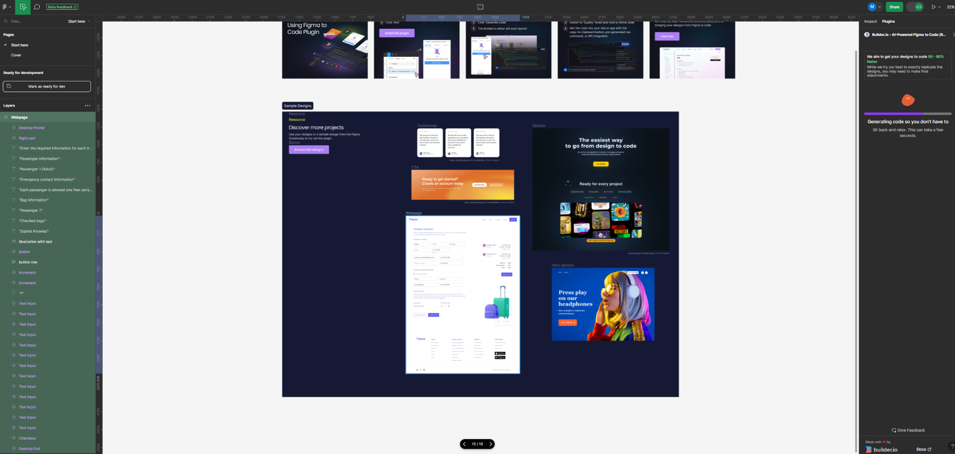

Slide 6
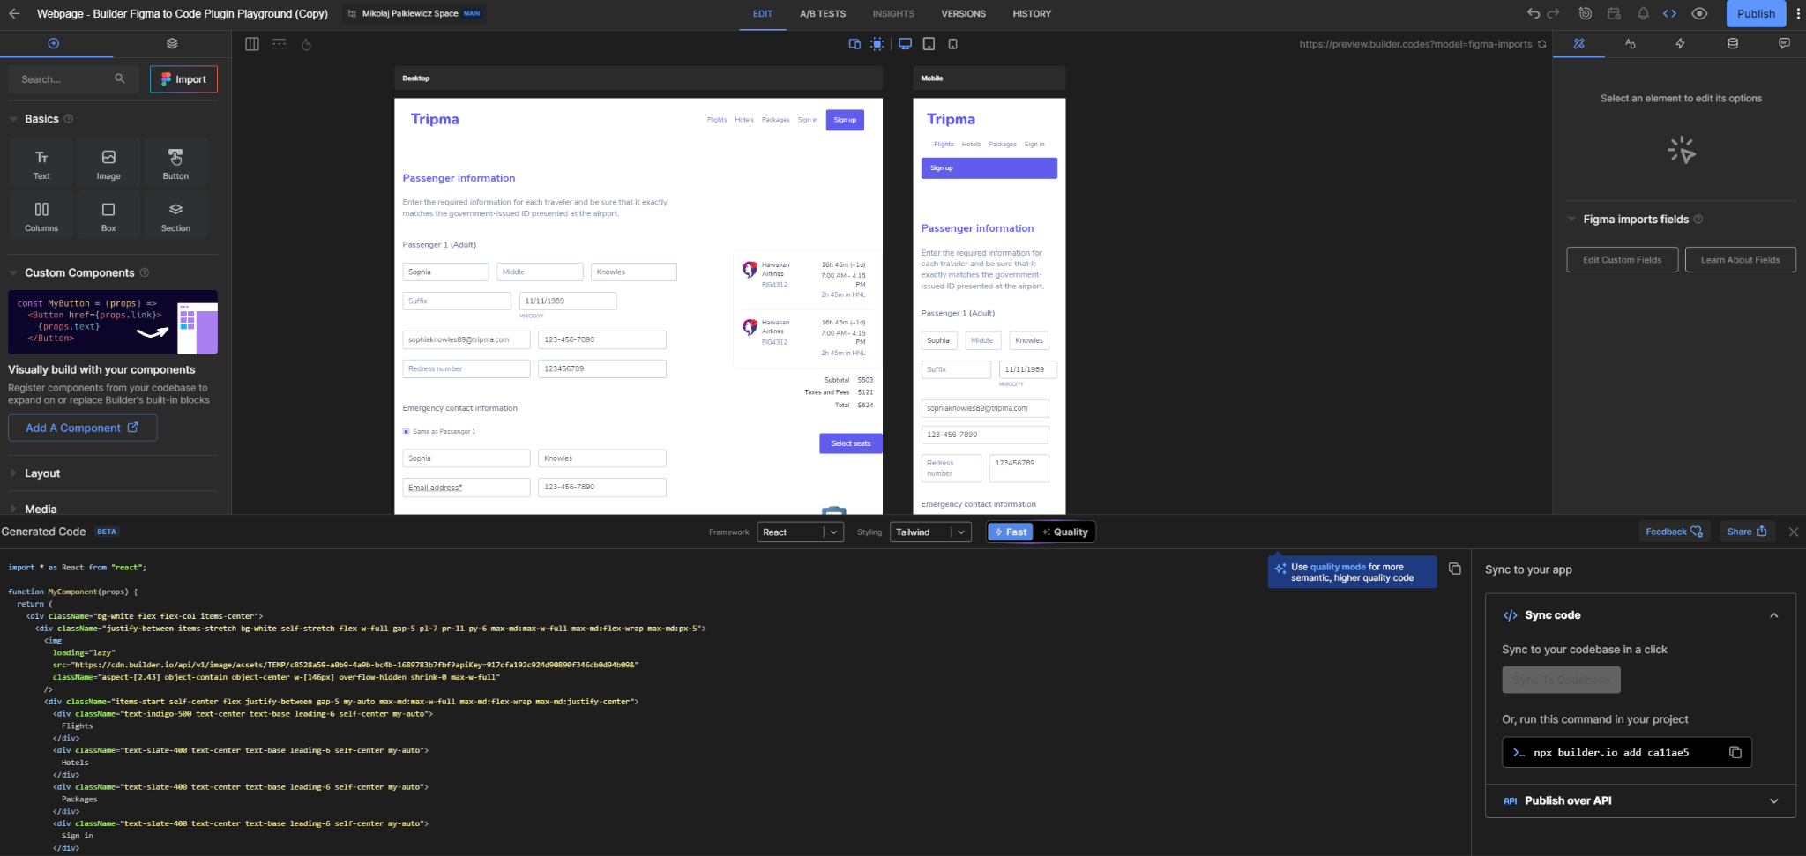

Slide 7
Switch between
frameworks

Slide 8
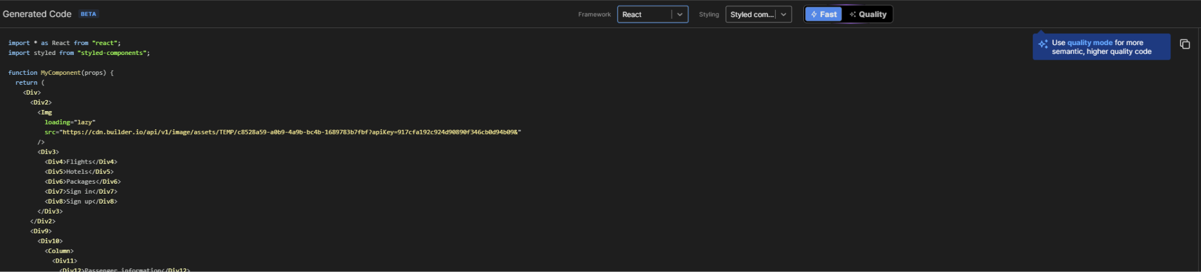
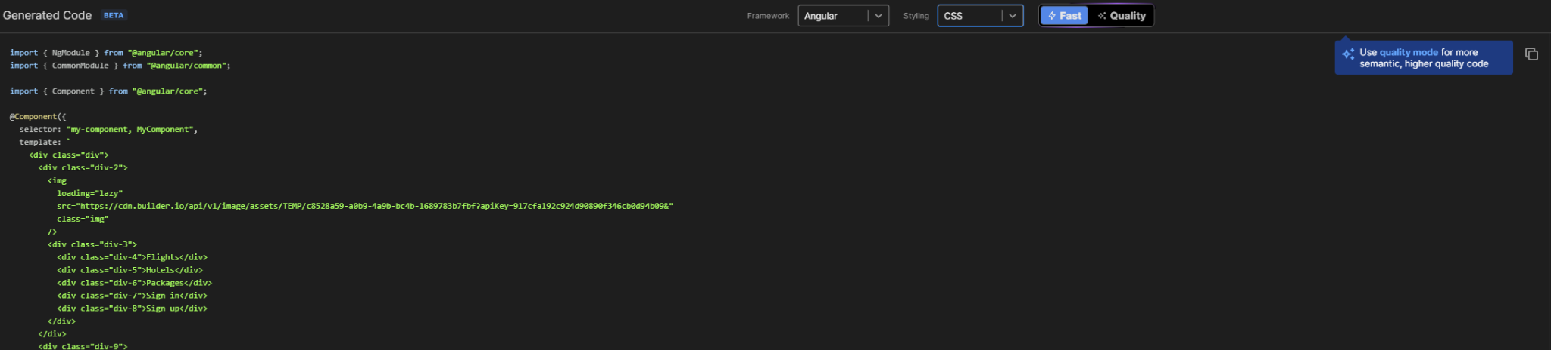

Slide 9
Code using
prompts

Slide 10
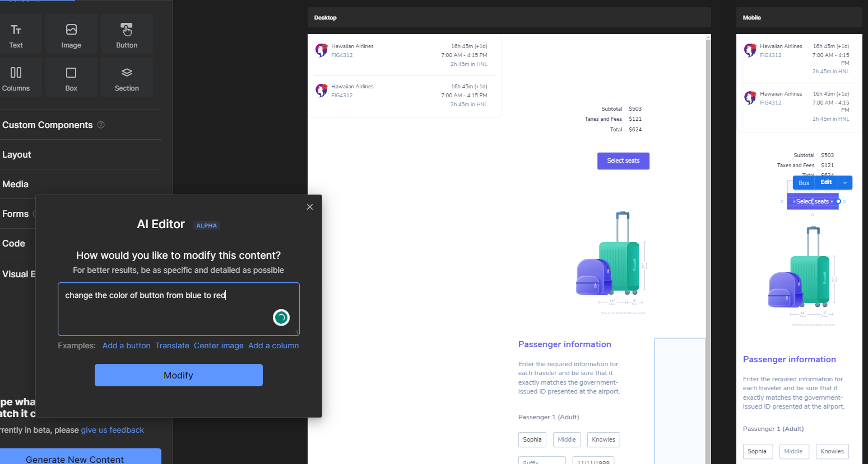

Slide 11
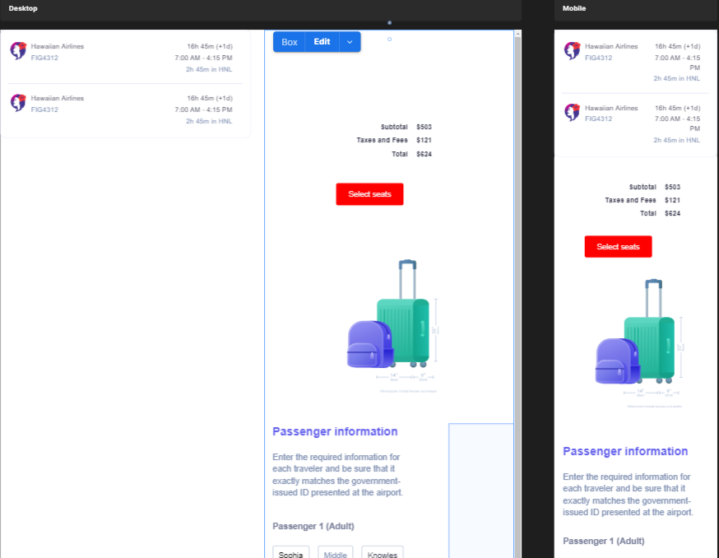

Slide 12
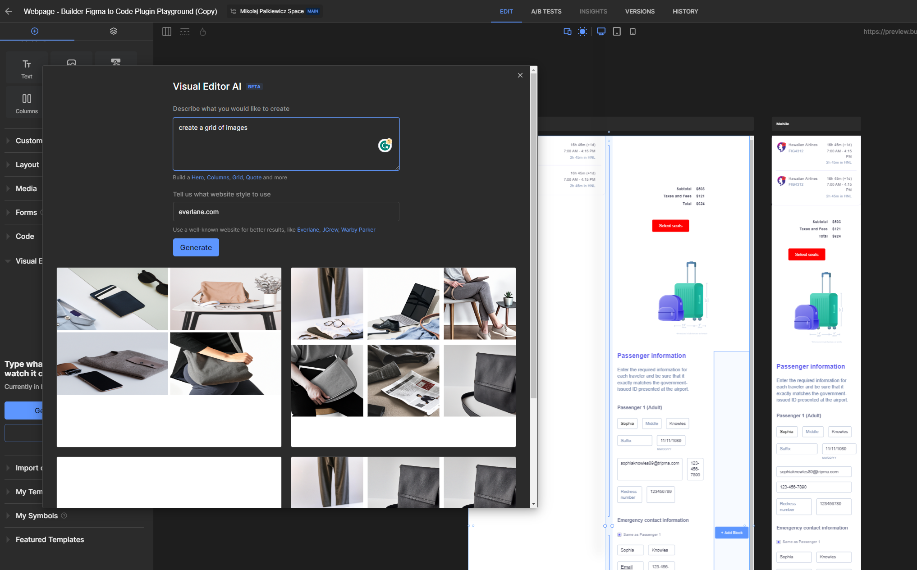

Slide 13
Chat to refine
the code

Slide 14
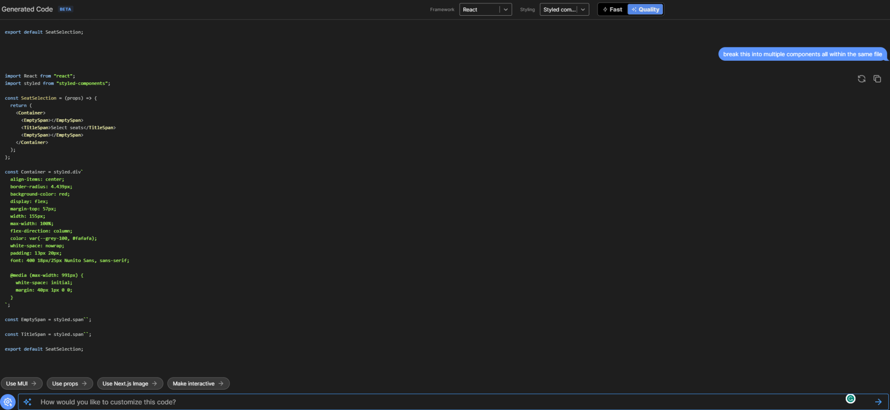

Slide 15
How does it work?

Slide 16
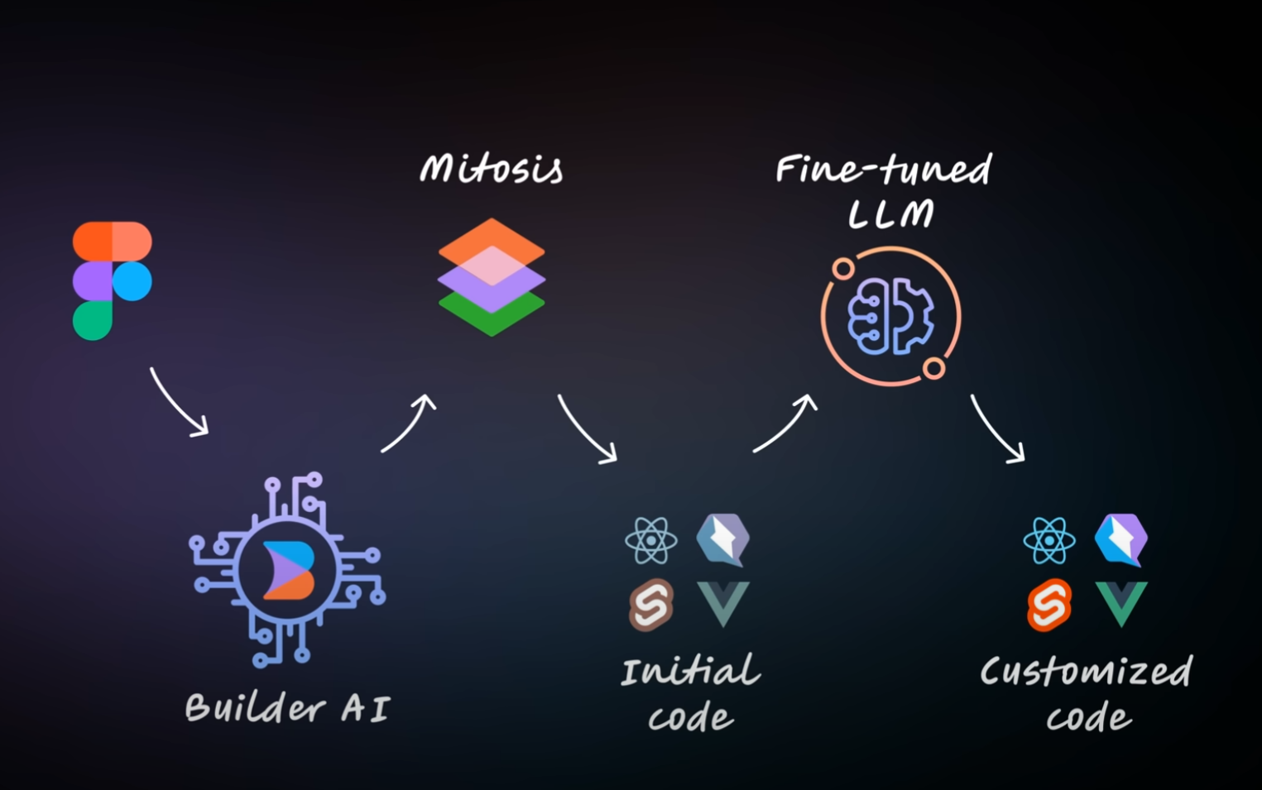

Slide 17
How does it work
Translates Figma designs into specialised format (in JSON)
Feeds the special format into custom fine-tuned LLM (100k tokens/s, unlimited context window)
Translates the AI output to the final code format in react/vue/…

Slide 18
Thank you

